Slide 1

Graph Algorithms
Mathematical Structures for Computer Science
Chapter 7
Copyright © 2014 W.H. Freeman & Co. MSCS Slides Section 7.1

Slide 2
Introduction
We confine our attention to (unweighted) directed graphs with no parallel arcs.
  Two arcs from node a to node b would be parallel, but one arc from a to b and another from b to a are not parallel arcs.
The adjacency matrix of the graph is an n × n matrix, not necessarily symmetric.
The adjacency matrix will be a Boolean matrix, that is, a matrix whose only elements are 0s and 1s.
There is a one-to-one correspondence between an n × n Boolean matrix and the directed graph that the matrix represents.
Directed graphs
with n nodes,
no parallel arcs
n×n Boolean
matrices
Section 7.1
Directed Graphs and Binary Relations

Slide 3
Directed Graphs and Binary Relations
Suppose G is a directed graph with n nodes and no parallel arcs. Let N be the set of nodes.
If (n_{i}, n_{j}) is an ordered pair of nodes, then there either is or is not an arc in G from n_{i} to n_{j}.
We can use this property to define a binary relation on the set N. This relation is the adjacency relation of the graph. n_{i} ρ n_{j} ↔ there is an arc in G from n_{i} to n_{j}
Conversely, if ρ is a binary relation on a set N, we can define a directed graph G with N as the set of nodes, and an arc from n_{i} to n_{j} if and only if n_{i} ρ n_{j}. G will have no parallel arcs.
Section 7.1
Directed Graphs and Binary Relations

Slide 4
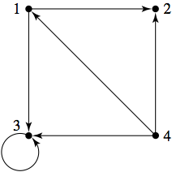
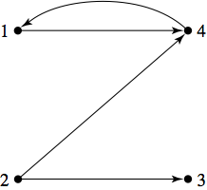
Directed Graphs and Binary Relations
For the directed graph of the figure below, the adjacency relation is {(1, 2), (1, 3), (3, 3), (4, 1), (4, 2), (4, 3)}.
For the set N {1, 2, 3, 4} and the binary relation {(1, 4), (2, 3), (2, 4), (4, 1)} on N, we obtain the associated directed graph:
Section 7.1
Directed Graphs and Binary Relations

Slide 5



Directed Graphs and Binary Relations
We have the following one-to-one correspondences:
If function composition is carried out on these bijections, the result is a bijection that gives us a one-to-one correspondence between binary relations and matrices.
Recall the reflexive, symmetric, antisymmetric, and transitive properties of a binary relation on a set.
If a binary relation on a set N has a certain property, this will be reflected in the corresponding graph and the corresponding Boolean matrix.
Section 7.1
Directed Graphs and Binary Relations

Slide 6
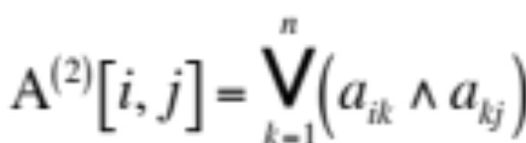
Reachability
DEFINITION: REACHABLE NODE In a directed graph, node n_{j} is reachable from node n_{i} if there is a path from n_{i} to n_{j}.
The “reachability” property has an interesting interpretation in each of the three equivalent forms in directed graph, adjacency relation, and adjacency matrix.
The adjacency matrix A of a directed graph G with n nodes and no parallel arcs will have a 1 in position i,j if there is an arc from n_{i} to n_{j}.
Let A⁽²⁾ be the Boolean matrix multiplication A × A given by:
Section 7.1
Directed Graphs and Binary Relations

Slide 7
Reachability
If a term such as a_{i2} ∧ a_{2j} in this sum is 0, then either a_{i2} = 0 or a_{2j} = 0 (or both), and there is either no path of length 1 from n_{i} to n₂ or no path of length 1 from n₂ to n_{j} (or both).
  Thus there are no paths of length 2 from n_{i} to n_{j} passing through n₂.
A path of length 2 from n_{i} to n_{j} will exist if and only if there is a path of length 2 passing through at least one of the nodes from 1 to n,
  that is, if and only if at least one of the terms in the sum is 1, A⁽²⁾[i, j] = 1.
The matrix A⁽²⁾ indicates the presence or absence of length-2 paths, this result holds for arbitrary powers and path lengths as well.
THEOREM ON BOOLEAN ADJACENCY MATRICES AND REACHABILITY: If A is the Boolean adjacency matrix for a directed graph G with n nodes and no parallel arcs, then A^{(m)}[i, j] = 1 if and only if there is a path of length m from node n_{i} to node n_{j}.
Section 7.1
Directed Graphs and Binary Relations

Slide 8
Reachability
If node n_{j} is reachable from node n_{i}, it is by a path of some length. Such a path will be shown by a 1 as the i, j entry in A or A⁽²⁾ or A⁽³⁾…
If there are n nodes in the graph, then any path with n or more arcs (n + 1 or more nodes) must have a repeated node.
  Therefore, we never need to look for a path from n_{i} to n_{j} of length greater than n.
To determine reachability, consult element i, j in
A, A⁽²⁾, ... , A^{(n)}.
We can define a reachability matrix R by:
R = A ∨ A⁽²⁾, ∨ ... ∨ A^{(n)}
n_{j} is reachable from n_{i} if and only if entry i, j in R is positive.
Section 7.1
Directed Graphs and Binary Relations

Slide 9
Reachability
If ρ is the adjacency relation for a graph G, we let R denote the binary relation of reachability (n_{i}, n_{j}) ∈ ρ^{R} exactly when there is a path in G from n_{i} to n_{j}.
ρ^{R} is the transitive closure of ρ
The three equivalent representations of adjacency relation, directed graph G, and adjacency matrix A, correspond to:
(n_{i},n_{j}) belongs
to the transitive closure of ρ
R[i,j] = 1, where
R = A ∨A⁽²⁾ ∨... ∨ A^{(n)}
n_{j} reachable from n_{i}
in G
Section 7.1
Directed Graphs and Binary Relations

Slide 10
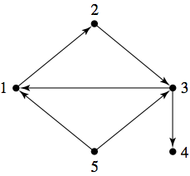
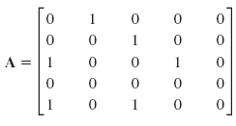
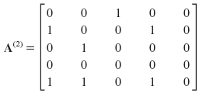
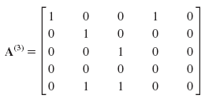
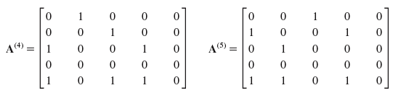
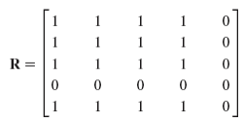
Reachability Example
A “1” placed at the intersection of row 1 and column 3 means that we can get from node 1 to node 3 in 2 arcs
Given the directed graph, G with 5 nodes:
The Adjacency Matrix is:
The Boolean Sum of the matrices is:
Section 7.1
Directed Graphs and Binary Relations

Slide 11
Reachability Example
The adjacency relation is ρ = {(1, 2), (2, 3), (3, 1), (3, 4), (5, 1), (5, 3)}.
Taking the transitive closure of ρ adds the following pairs: (1, 3), (2, 1), (2, 4), (3, 2), (5, 2), (5, 4), (1, 1), (1, 4), (2, 2), (3, 3).
So we have:
{(l, 1), (1, 2), (1, 3), (1, 4), (2, 1), (2, 2), (2, 3), (2, 4),
(3, 1), (3, 2), (3, 3), (3, 4), (5, 1), (5, 2), (5, 3), (5, 4)}
Notice that it agrees with matrix R.
Section 7.1
Directed Graphs and Binary Relations

Slide 12
Warshall’s Algorithm
For a graph G with n nodes, Warshall’s algorithm computes a sequence of n + 1 matrices M₀, M₁, M₂, ... , M_{n}.
For each k, 0 ≤ k ≤ n, M_{k}[i, j] = 1 if and only if there is a path in G from n_{i} to n_{j} whose interior nodes (i.e., nodes that are not the endpoints of the path) come only from the set of nodes {n₁, n₂, ... , n_{k}}.
Warshall’s algorithm begins with A = M₀ and M₁, M₂,... , M_{n} = R inductively.
The base case is to let M₀ = A.
  Assume that M_{k} has been computed, M_{k+1}[i, j] = 1 if and only if there is a path from n_{i} to n_{j} whose interior nodes come only from the set {n₁, n₂, ... , n_{k+1}}.
Section 7.1
Directed Graphs and Binary Relations

Slide 13
Warshall’s Algorithm
There are two ways to see if M_{k+1}[i, j] = 1
All the interior nodes come from {n₁, n₂, ... , n_{k}}, in which case M_{k}[i, j] = 1. Any 1 entries in M_{k} are carried forward into M_{k+1}.
Node n_{k+1} is an interior node. There must be a path from n_{i} to n_{k+1} whose interior nodes come from {n₁, n₂, ... , n_{k}} and a path from n_{k+1} to n_{j} whose interior nodes come from {n₁, n₂, ... , n_{k}}, so M_{k}[i, k + 1] = 1 and M_{k}[k + 1, j] = 1.
Section 7.1
Directed Graphs and Binary Relations

Slide 14
Warshall’s Algorithm
ALGORITHM Warshall
Warshall(n × n Boolean matrix M)
//Initially, M = adjacency matrix of a directed graph G //with no parallel arcs
for k = 0 to n - 1 do
for i = 1 to n do
for j = 1 to n do
M[i, j] = M[i, j] ∨ (M[i, k + 1] ∧ M[k + 1, j ])
end for
end for
end for
//at termination, M = reachability matrix of G
endWarshall
Section 7.1
Directed Graphs and Binary Relations

Slide 15
Warshall’s Algorithm
Informally, Warshall’s algorithm works as follows:
Consider column k + 1 in M_{k}.
For each row with a 0 entry in this column, copy that row to M_{k+1}.
For each row with a 1 entry in this column, or that row with row k + 1 and write the resulting row in M_{k+1}.
Section 7.1
Directed Graphs and Binary Relations

Slide 16
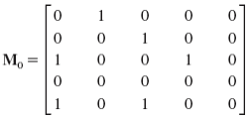
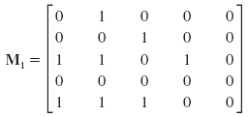
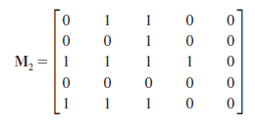
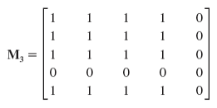
Warshall’s Algorithm Example
Given the follow graph:
The initial adjacency matrix is M₀
M₃ = M₄= M₅ = (not shown)
Section 7.1
Directed Graphs and Binary Relations

